Slide 1
Selenium with Python+GitHub
Agenda
Installing Python on Windows
Selenium Packages
Installing PyCharm IDE
Selenium WebDrivers
Some Knowledge Portals
PyTest Framework
Versioning with GitHub

Slide 2
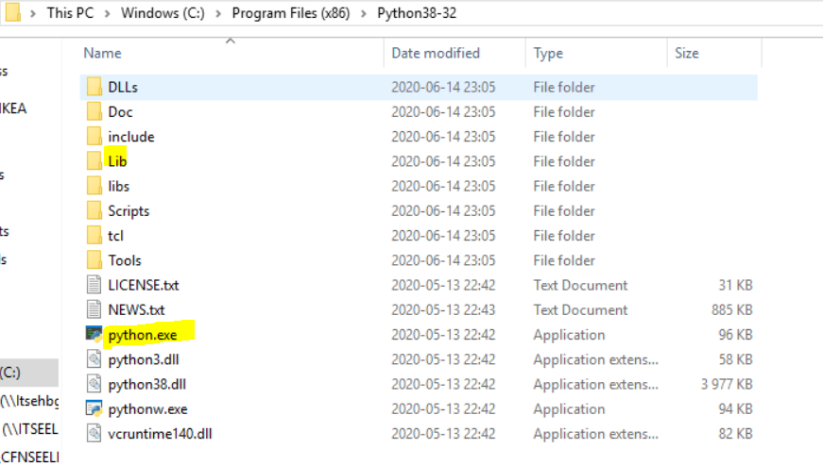
Installing Python
Download Python
(https://www.python.org/downloads/)
For more Learning: https://www.jetbrains.com/pycharm-edu/
As i have already installed Pycharm i opted for plugin install
EduTools. Pycharm Edu is free & open source.
Learn Programming here (Choose your track as Python):
https://www.jetbrains.com/academy/
Verify the installation

Slide 3
Installing Selenium Libraries
Install Selenium Libraries for Python
This is the command: pip install –U selenium
Alternatives:
https://selenium-python.readthedocs.io/installation.html
https://pypi.org/project/selenium/
Lib and script folders updated with selenium packages

Slide 4
PyCharm IDE and WebDrivers...
Install PyCharm IDE
https://www.jetbrains.com/pycharm/download
Check selenium library and settings (Pre requisites)
Write a simple code to check it works
Let’s download Chrome, IE and Firefox Drivers
https://www.selenium.dev/downloads/
https://pypi.org/project/selenium/
For MS Edge browser: https://developer.microsoft.com/en-us/microsoft-edge/tools/webdriver/
KM: https://github.com/SeleniumHQ/selenium/wiki/InternetExplorerDriver#required-configuration
Sample Demo Application can be used: http://newtours.demoaut.com/

Slide 5
Pytest Framework
Pip install –U pytest
https://docs.pytest.org/en/latest/contents.html
https://github.com/chinmaya1155/cks-14062020
Download Git: https://git-scm.com/downloads

